Slide 1

Advanced Programming Practices (SOEN 6441)
Project Build 1 – Team 19
Meetkumar Kalariya | 40293692
Nen Patel | 40291812
Tushar Jain | 40274220
Amal Gupta | 40293339
Rushin Makwana | 40221949
Notes:
Hello, we are team 19 and we will be demonstrating our build 1 today.
Our team consist of 5 members, names and id are mentioned on the slide.

Slide 2




Tools and Libraries used for the project
IntelliJ IDE
JDK 21 and Junit 5
GitHub for Version Control and Progress Board
GitHub Actions for CI/CD workflow

Slide 3
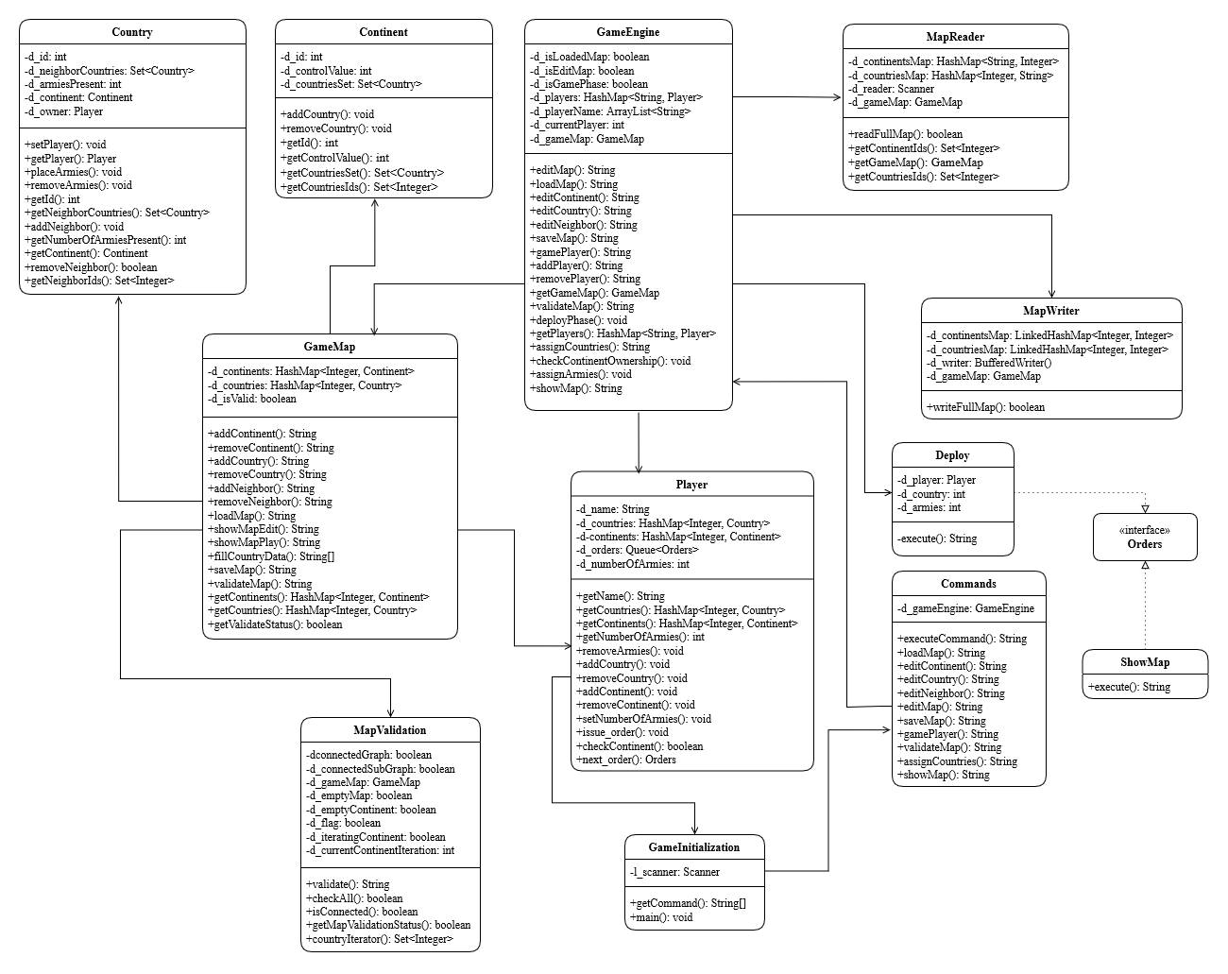
Architectural Design Diagram
Notes:
First up we have the Architectural diagram for our software.

Slide 4
Java Class Brief Introduction
Notes:
Let me give a brief introduction for our class.

Slide 5
GameInitialization.java
The GameInitialization class is the main entry point for the game application.
It is responsible for initializing the game, taking user commands, and managing the game loop.

Slide 6
Commands.java
The Commands class is responsible for executing user commands in the game.
It contains a GameEngine object and several methods to handle different types of commands.

Slide 7
GameEngine.java
The GameEngine class is the core of the game application.
It manages the game logic, including loading and editing maps, adding and removing players, validating maps, and managing game phases.
Notes:
Map ops and player ops commands

Slide 8
GameMap.java
The GameMap class represents the game map in the application.
It contains several fields and methods related to the map's state and actions in the game.

Slide 9
Continent.java and Country.java
The Continent class represents a continent in the game.
It contains several fields and methods related to the continent's state and actions in the game.
The Country class represents a country in the game.
It contains several fields and methods related to the country's state and actions in the game.

Slide 10
MapReader.java
The MapReader class is responsible for reading the game map data from a map file.
It contains several fields and methods related to the map reading process.

Slide 11
MapWriter.java
The MapWriter class is responsible for writing the game map data into a map file.
It contains several fields and methods related to the map writing process.

Slide 12
MapValidation.java
The MapValidation class is responsible for validating the game map.
It checks whether the map is connected, whether continents are connected, and whether there are any empty continents or countries.

Slide 13
Showmap.java
This class is used to represent a show map order in a game, which is used to display the current state of the game map.
Notes:
Current status of the gamemap

Slide 14
Player.java
The Player class represents a player in the game.
It contains several fields and methods related to the player's state and actions in the game.

Slide 15
Deploy.java
This class is used to represent a deploy order in a game, which is used to place reinforcements in a country controlled by a player.
Notes:
This class is used to deploy armies by the player which they own.

Slide 16
Test Cases
We have also implemented the test cases for all the class and we have used Junit version 5.

Slide 17
GitHub Progress Board
We have leveraged GitHub progress board template to track the task and their progress.

Slide 18

CI/CD with GitHub Action
The maven.yml file is a configuration file for GitHub Actions.
This file defines a workflow that automates the process of building, testing, and releasing a Java project with Maven.
Trigger
The workflow is triggered on every push and pull_request event to the main branch.
Jobs
The workflow includes several jobs that are executed on an ubuntu-latest environment
Release
If all jobs are successful and the event is a push to the main branch, it triggers a release job that creates a new release of the software. The version number of the release is v1.0. followed by the run number of the workflow.

Slide 19
Thank You
Project Build 1 – Team 19
Meetkumar Kalariya | 40293692
Nen Patel | 40291812
Tushar Jain | 40274220
Amal Gupta | 40293339
Rushin Makwana | 40221949

